Slide 1
Support Vector Machines (SVM)

Slide 2
SVM - Topics
Introduction to SVM
Property of line in Perceptron Algorithm
How SVM looks in 2D space
Kernel SVM
Parameters of SVM.
Case study on SVM
2

Slide 3
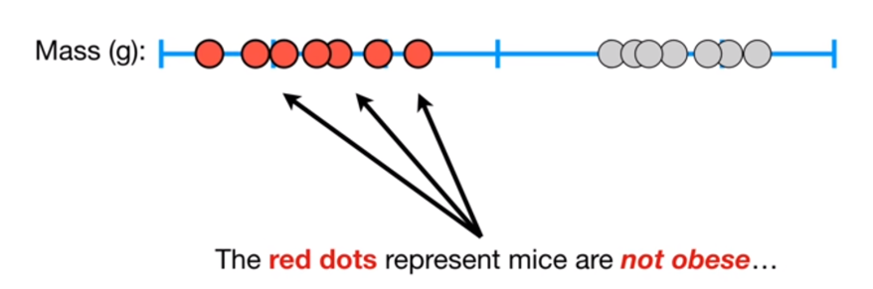
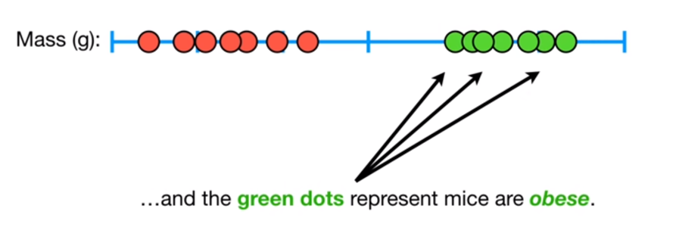
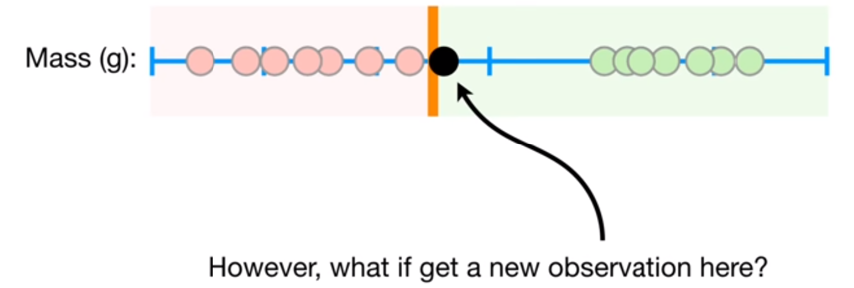
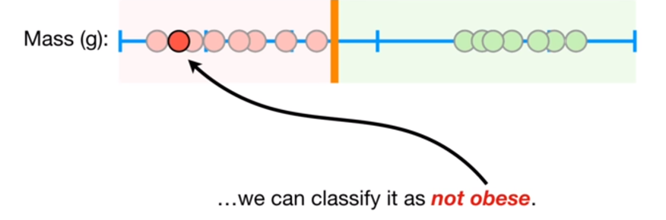
Support Vectors – What are they?

Slide 4
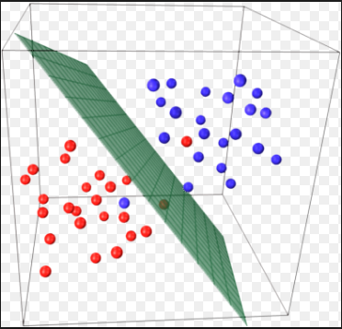
Introduction to SVM
Known as maximum-margin hyperplane, finds the linear model with max margin. Unlike the linear classifiers, objective is not minimizing sum of squared errors but finding a line/plane that separates two or more groups with maximum margins.

Slide 5
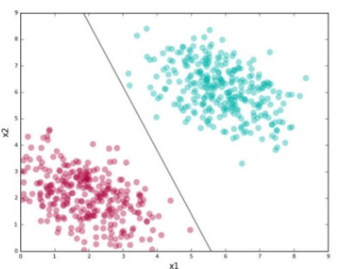
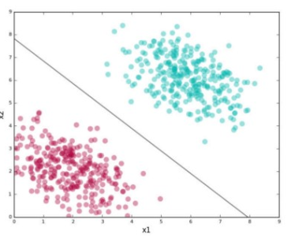
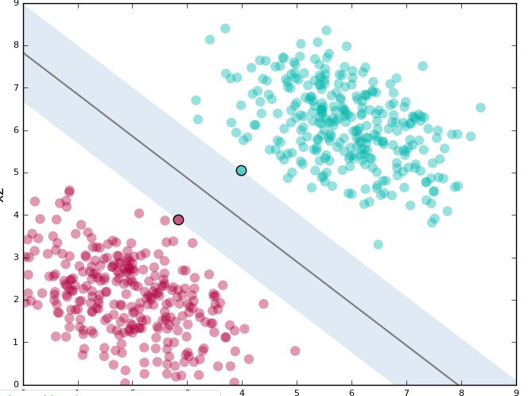
Introduction to SVM
First line does separate the two sets but id too close to both red & green data points.
Chances are that when this model is put in production, variance in both cluster data may force some data points on wrong side

Slide 6
Introduction to SVM Contd.
The second line doesn’t look so vulnerable to the variance. The two points nearest from different clusters define the margin around the line and are support vectors.
SVMs try to find the second kind of line where the line is at max distance from both the clusters simultaneously.
The Perceptron
The perceptron is an algorithm used to produce a binary classifier. That is, the algorithm takes binary classified input data, along with their class membership, and outputs a line that attempts to separate data of one class from data of the other: data points on one side of the line are of one class and data points on the other side are of the other.

Slide 7
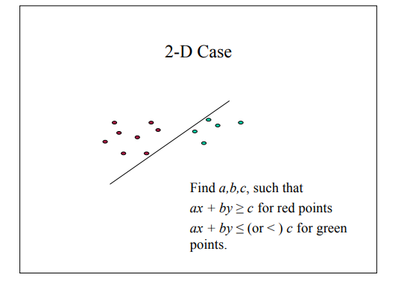
How SVM looks in 2D space
In a 2d space, the separating plane is a line.
As described, the Perceptron tries to do the same
The fig1 at the right shows a possible line.
This line when put to classification for unseen data, is more prone to errors because of the variance in data.
The SVM uses a line that looks more like fig2
The hyperplane is a plane that acts as the decision boundary.
Fig1 - A separating line
Fig2 - An optimal separating line (SVM)

Slide 8
How SVM looks in 2D space
Which Hyperplane to pick?
Lots of possible solutions for a,b,c.
Some methods find a separating hyperplane, but not the optimal one (e.g., neural net).
But: Which points should influence optimality?
– All points?
- Linear regression
- Neural nets
– Or only “difficult points” close to decision boundary
- Support vector machines

Slide 9
Kernel SVM
We know that when we transform the mathematical space from 2 dimensions to higher dimension, the probability of linearly separating the data points increases.
Now given that we have only 2 dimensions x1 and x2, how to create more dimensions out of it? We transform higher mathematical space into dimensions which are polynomials.
x_{1,} x_{2,} x₁², x₂²,…each one of them is 1 dimension in the mathematical space. Kernel SVM (KSVM) takes data point to higher mathematical space where they become linearly separable and then draw the plane through the data points.

Slide 10
Some parameters of SVM
Kernel
Used to specify the type of kernel we choose to describe the data points. We need kernels as data when scaled on higher dimensions has a higher probability of being linearly seperable. In sklearn, we can use many kernels such as – rbf, poly, sigmoid, linear, precomputed etc.
C
Defines the misclassification error of the model
if set to high, will have a very high penalty for the misclassified points and vice versa.
Gamma
Defines the radius of influence of data points in classification.
By Increasing gamma, we have a tight radius of influence of the data points in the classification.
These parameters need to be tried for different values to come to the optimum value/ highest accuracy model.

Slide 11
Industry applications of SVM
text (and hypertext) categorization
image classification
bioinformatics (Protein classification, Cancer classification)
handwritten character recognition

Slide 12
Case study
Cancer detection using SVM
Objective:
Using historical data about patients who were diagnosed with cancer, enable the doctors to confidently differentiate malignant cases from benign given the independent attributes.
Prepare the data and create the model.

Slide 13
Dataset
https://archive.ics.uci.edu/ml/datasets/Breast+Cancer+Wisconsin+(Original)
Attribute Information:
1. Sample code number: id number
2. Clump Thickness: 1 - 10
3. Uniformity of Cell Size: 1 - 10
4. Uniformity of Cell Shape: 1 - 10
5. Marginal Adhesion: 1 - 10
6. Single Epithelial Cell Size: 1 - 10
7. Bare Nuclei: 1 - 10
8. Bland Chromatin: 1 - 10
9. Normal Nucleoli: 1 - 10
10. Mitoses: 1 - 10
11. Class: (2 for benign, 4 for malignant)

Slide 14
Steps to follow
Import Libraries and Data
Data Preparation and analysis
Split the dataset into training and test datasets
Build a Support Vector Machine with different kernels
Compare the accuracies

Slide 15


Questions?

